Slide 1

Internet of Things (IoT)
Puneet Reddy (Nov 2020) Technical Consultant CSS Corp.

Slide 2
Overview
What is IoT and why is it important?
History of IoT
Applications
Architecture
Cloud Computing in IoT (Fog/Edge Computing)
Getting Started with IoT
Future Trends
Careers in IoT

Slide 3

What is IoT?
What exactly are these “Things” and why should we care?

Slide 4
What is IoT - Definitions
The Internet of things (IoT) describes the network of physical objects—“things”—that are embedded with sensors, software, and other technologies for the purpose of connecting and exchanging data with other devices and systems over the Internet. - Wikipedia
Various standards attempt to define IoT:
IEEE
ETSI
OneM2M
ITU
IETF
W3C
And many others
Notes:
IoT vs IoE

Slide 5
What is IoT – ITU Definition
IoT
Any Time
Any Place
Any Thing

Slide 6
What is IoT - Features
Connect
Device Virtualization
High Speed Messaging
Endpoint Management
Analyse
Stream Processing
Data Enrichment
Event Stores
Integrate
Enterprise Connectivity
REST APIs
Command and Control

Slide 7
What is IoT – Why does it Matter?
Advantages
Challenges
Minimizes Human Effort
Optimizes Resource Utilization
Saves Time
Automation and Control
Better Quality of Life
Information & Data
Compatibility
Complexity
Lesser Employment of Menial Staff
Technology Takes Control of Life
Security
Immense Data Volumes
Notes:
Compatibility – Basket of Remotes

Slide 8
What is IoT - Examples
Home Automation – Smart Homes
Smart Cities
Industrial Automation
Medical Applications
Smart Environment
Agriculture

Slide 9
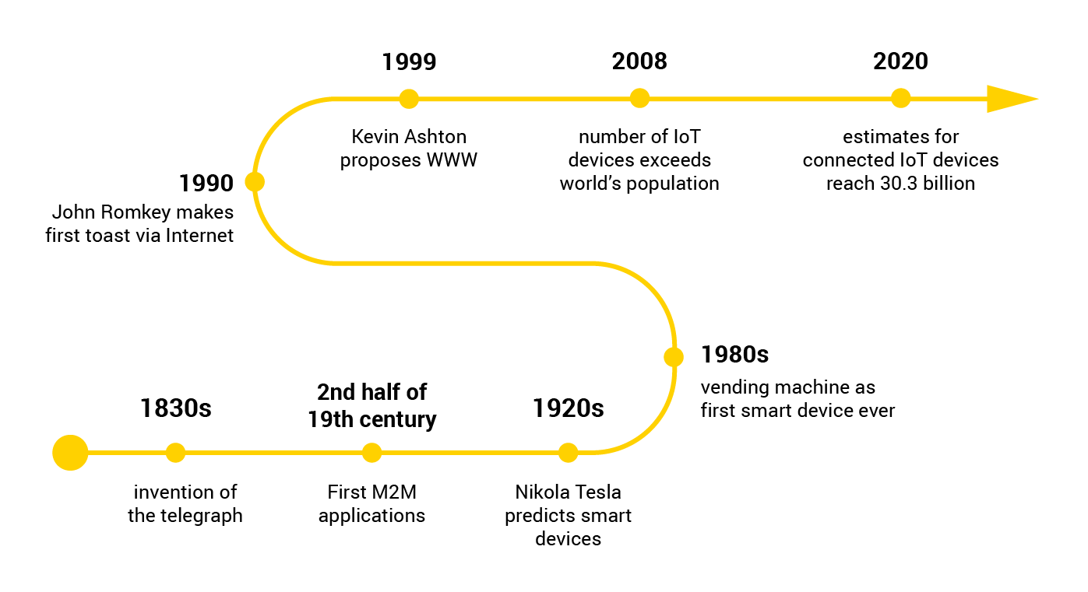
History of IoT
When it all started and what’s been done

Slide 10
History of IoT
1912
The first telemetry system was rolled out in Chicago way back in 1912. It is said to have used telephone lines to monitor data from power plants.
1930s
Telemetry expanded to weather monitoring in the 1930s, when a device known as a radiosonode became widely used to monitor weather conditions from balloons.
1957
In 1957 the Soviet Union launched Sputnik, and with it the Space Race. This has been the entry of aerospace telemetry that created the basis of our global satellite communications today.
1980s
Broad adoption of M2M technology begin in the 1980s with wired connections for SCADA (supervisory control and data acquisition) on the factory floor and in home and business security systems.

Slide 11
History of IoT
1982
In 1982, Carnegie Melon University had the first “Thing” connected to the internet; a coke dispenser mahine.
1990s
In the 1990s, M2M began moving towards wireless technologies. ADEMCO built their own private radio network to address intrusion and smoke detection because budding cellular connectivity was too expensive.
1995
In 1995, Siemens introduced the first cellular module built for M2M
1999
The term IoT was coined in 1999
Now
Mike Zuckerberg has a home automation system called Jarvis, modelled after the fictional AI with the same name from the iron man movies.
Notes:
Coined by Kevin Ashton when working on supply chain optimization at Procter & Gamble – To attract management’s attention to RFID

Slide 12
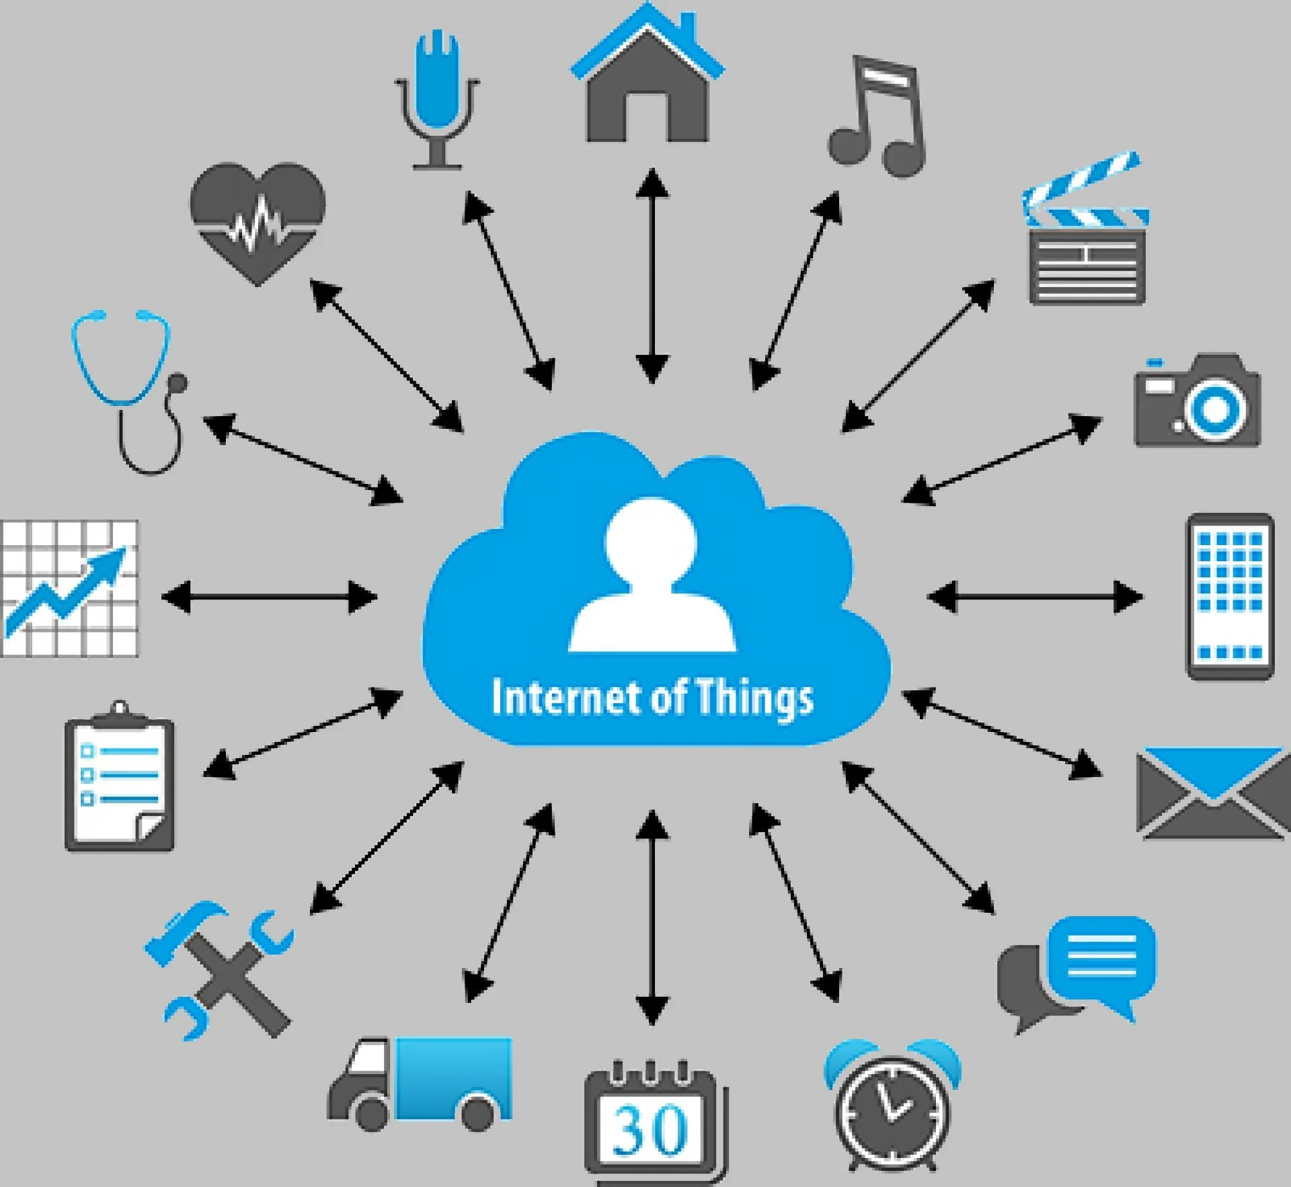
Applications
Where is IoT used?

Slide 13
Applications - Industrial
Oil and Gas
Power – Smart Grids
Manufacturing
Agriculture
Maintenance

Slide 14
Applications - Consumer
Smart Homes
Elderly Care
Security
Wearable Tech
Personal Assistants

Slide 15
Applications - Organizational
Medical and Healthcare
Transportation and Logistics
V2X Communications
Communications
Building and Home Automation
Retail and Supply Chain
Notes:
Amazon Go
Medical and Healthcare
Transportation and Logistics
V2X Communications
Building and Home Automation
Retail & Supply Chain

Slide 16

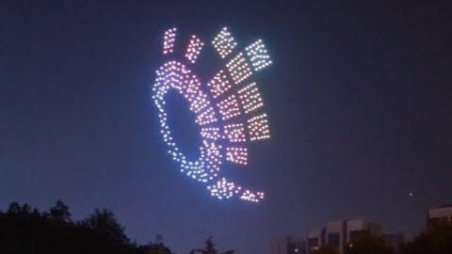

Applications - Military
Ocean Of Things
Internet of Battlefield Things
Notes:
Internet of Battlefield Things
Ocean of Things – DARPA – Défense Advanced Research Projects Agency

Slide 17
Architecture
Perception
Network
Application
What is iot made of?

Slide 18
Architecture - Tiered
3 Tier
Perception Layer
Network Layer
Application Layer
5 Tier
Perception Layer
Transport Layer
Middleware/Processing Layer
Application Layer
Business Layer

Slide 19
Architecture – Perception Layer
RFID
Infrared
Cameras
Neural
Medical
Environmental
Chemical/Bio

Slide 20
Architecture – Network Layer
Addressing & Identification
Lower Power Communication
Lossless
low Memory Routing Protocol
NFC Communication
RFID & WSN integration
Bluetooth Low Energy
Low Power WiFi
zigbee (10-100m range)
Notes:
Perception – RFID, Infrared, Cameras, Neural, Medical, Environmental, Chemical/Bio
Network – Addressing & Identification, Lower power communication, Lossless, low memory routing protocol, NFC communication 13.6mhz, rfid & WSN integration, Bluetooth Low Energy, Low Power WiFi, zigbee (10-100m range)
Middleware – Interoperability & programming abstraction, device discovery and management, scalability, big data analytics, security and privacy, cloud services, context detection?

Slide 21
Architecture – Middleware Layer
Interoperability & Programming Abstraction
Device Discovery and Management
Scalability
Big Data Analytics
Security and Privacy
Cloud Services

Slide 22
Architecture – Application Layer
This is where the actual processing of the data and value addition takes place. Things such as data science, AI, graphic data representation, visualization and user interfaces exist in this layer.

Slide 23
Architecture – Business Layer
This is the meta-layer which manages the whole IoT system, including applications and business related metrics.

Slide 24
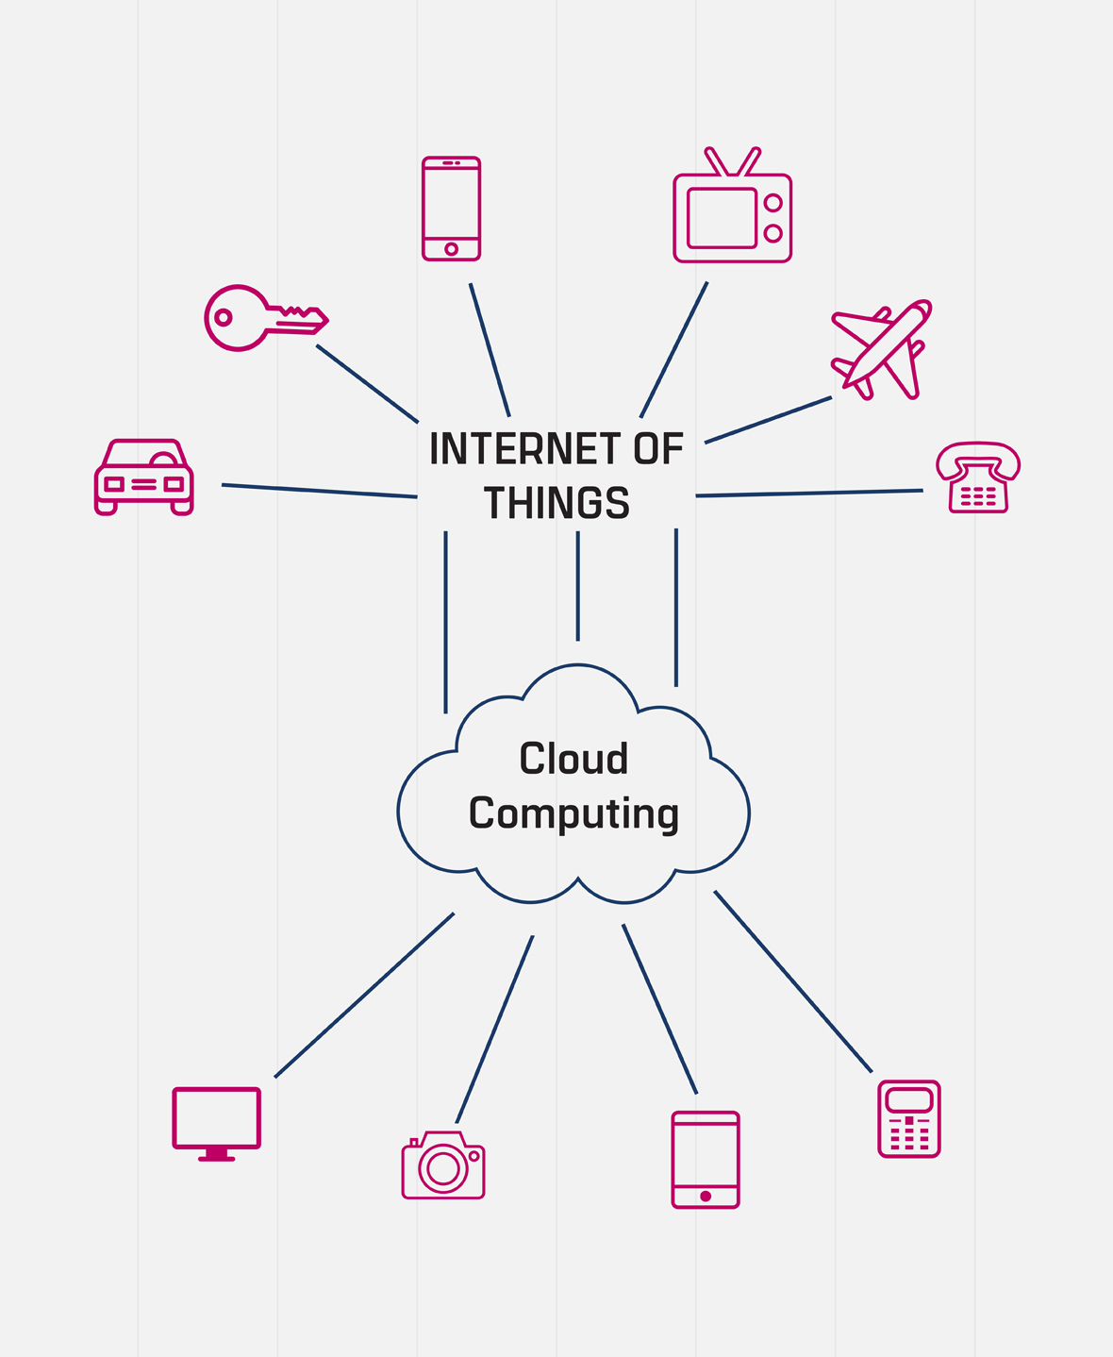
Cloud Computing in IoT
What is cloud computing and why is it a good fit for IOT?

Slide 25
Cloud Computing
Cloud computing is the on-demand availability of computer system resources, especially data storage (cloud storage) and computing power, without direct active management by the user. The term is generally used to describe data centers available to many users over the Internet.
Distributed
Scalable
Availability
Security
Device and Location Independence
Cost effective

Slide 26
Cloud Computing for IoT
IoT Requirements
Cloud Solutions
Interoperability
Location Independence
Secure
On Demand Storage & Computation
Heterogeneous Protocols
Language & Platform Agnostic
Distributed by Design
Multiple Security Models
IaaS, Serverless, PaaS, SaaS, FaaS
Message Queues, Bridges and Connectors

Slide 27

Fog Computing
Fog computing is a decentralized computing infrastructure in which data, compute, storage and applications are located somewhere between the data source and the cloud.

Slide 28
Edge Computing
In Edge computing, the (pre)processing of data happens on the very periphery of the network.

Slide 29
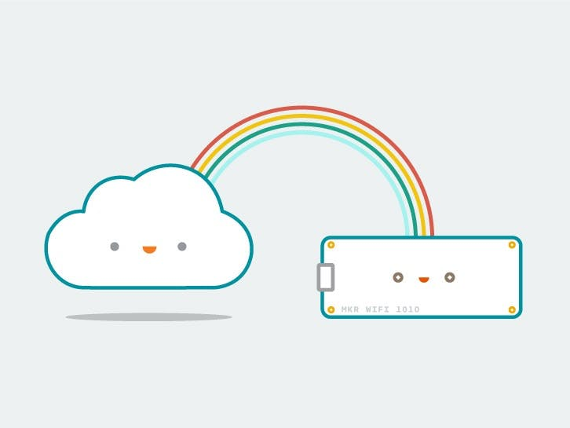
Getting Started
How can I start leveraging IOT?

Slide 30
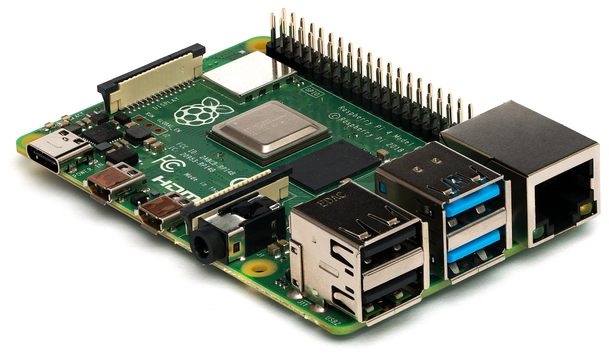
Getting Started – Raspberry Pi
A single board computer
Low Cost
Highly Extensible
Build for Python
Easy to Use
Low Learning Curve
By Miiicihiaieil Hieinizilieir / Wikimedia Commons, CC BY-SA 4.0, https://commons.wikimedia.org/w/index.php?curid=80140656
Notes:
Meant to run with a power supply

Slide 31
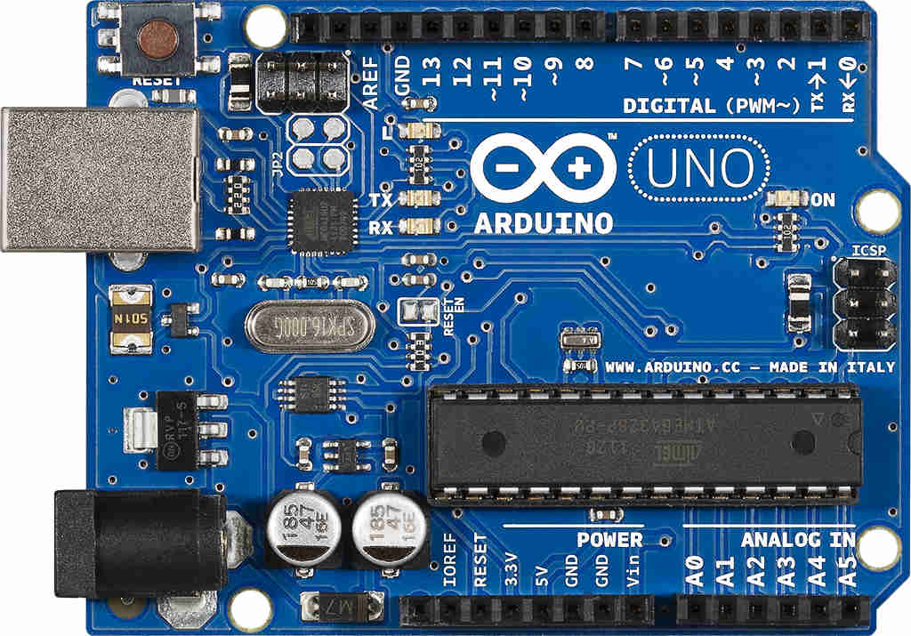
Getting Started – Arduino
Commodity Microcontroller
Low Cost
No OS
Programmable in C++
Used to Control Peripheral Devices
Low Power Consumption (~50mA)
Notes:
Meant to run on a battery

Slide 32
Future Trends
Hyperautomation
Multiexperience
Democratization of Expertise
Human Augmentation
Transparency and Traceability
The Empowered Edge
Distributed Cloud
Autonomous Things
Practical Blockchain
AI Security
Science Fiction or Reality?
Notes:
From the Gartner IT symposium 2020
Hyperautomation Started with RPA but is way beyond it now
VR, AR, MR Technology literate people to people literate technology
Neuralink

Slide 33
Careers in IoT
Roles
Salary Trends
Companies Hiring IoT Professionals
Emerging Roles for IoT Professionals
Skills Required
What sort of skills are required and what does the job entail?

Slide 34
Roles in IoT
Solution Architect
Product Manager
Industrial Data Scientist
Industrial Engineer
Fuller Stack Developer
IoT Cloud Architect/Cloud Engineer

Slide 35
Salary Trends in IoT (2017 Data)
Median salary 15.2 lpa
IoT Professionals receive 76% higher salaries than IT Professionals in India
92% of freshers start at less than 6L
High growth industry with forecasted CAGR or 24.7%

Slide 36
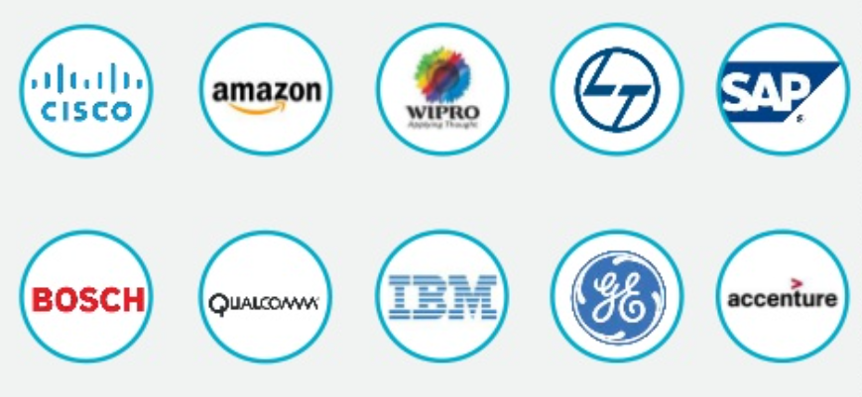
Companies Hiring IoT Professionals

Slide 37
Emerging Roles in IoT
Chief Internet of Things Officer (CioTO)
Robot Coordinator
Neural Implant Tech Expert
Ethics Officer

Slide 38
Skills Required
Sensors and Industrial Controllers
Security
Data Analytics
Business Intelligence
UI/UX Design
Mobile/Remote Development
Hardware Engineering
Networking/ Communications Technologies
Cloud Technologies

Slide 39
Ubiquitous computing is roughly the opposite of virtual reality. Where virtual reality puts people inside a computer-generated world, ubiquitous computing forces the computer to live out here in the world with people.
- Mark Weiser

Slide 40
References
https://www.happiestminds.com/Insights/internet-of-things/
https://www.iotforall.com/what-is-iot-simple-explanation/
https://internetofthingsagenda.techtarget.com/definition/Internet-of-Things-IoT
https://en.wikipedia.org/wiki/Internet_of_things
https://standards.ieee.org/content/dam/ieee-standards/standards/web/documents/other/iot.pdf
https://www.itu.int/en/action/broadband/Documents/Harnessing-IoT-Global-Development.pdf
https://securitytoday.com/articles/2020/01/13/the-iot-rundown-for-2020.aspx
GSR Interoperability Discussion Paper by Urs Gasser, Berkman Center
Manyika, James, et. al., The Internet of Things: Mapping the Value beyond the Hype. McKinsey Global Institute, June 2015
GSR Discussion Paper on IoT by Prof. Ian Brown, Oxford Internet Institute
“Big Data for a More Resilient Future”, World Bank Group/ 2015 Spring Meetings, Big Data for Development, Summary of Projects.
Kevin Ashton, “That ‘Internet of Things’ Thing, in the real world things matter more than ideas,” RFID Journal, June 22, 1999
http://www.gartner.com/newsroom/id/3165317
Vodafone press release, “Delivering M2M communications for the global business”, 30 April 2009

